Slide 1
Cell Viability TRAMP-C1 Cells Treated with Genistein or Daidzein (MTS Experiment #4)
Davit Sargsyan, 06/10/2016

Slide 2
Experiment Timeline
Sunday 06/04/2016, 8:30 PM: 3 x 96-well plates were seeded with 10^3 TRAMP-C1 cells per well.
Monday 06/05/2016, 8 PM: 8 doses of GEN and DAI were applied to the plates (90 μM starting dose, serial dilution 1/2) , columns 2 to 10; column 11 was left as a positive control 0.1% DMSO; edges were filled with medium.
Plate # 3 was re-dosed on Tuesday 06/07/2016

Slide 3
Design and Analysis
Monday – Wednesday (06/06/2016 to 06/08/2016): every day, for 3 consecutive days, one plates was taken out, MTS was applied to wells, and plate readings were taken 2 hours later.
Data was analyzed using R 3.2.1. The estimates and plots were obtained using my robust 4-parameter curve fitting R package ‘ricf’.

Slide 4
Plate Layout

Slide 5
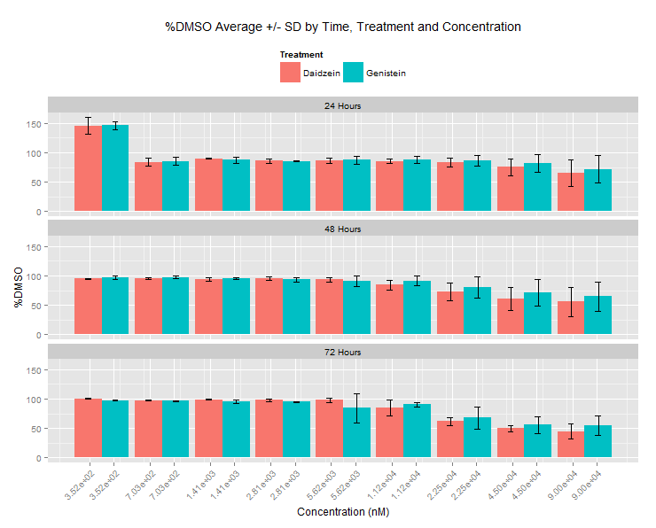
Barplot with Error Bars: %DMSO Average +/-SD

Slide 6
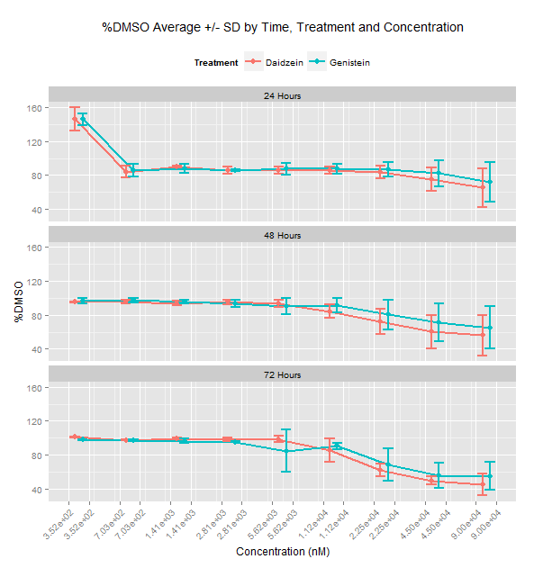
Lineplot with Error Bars: %DMSO Average +/-SD

Slide 7
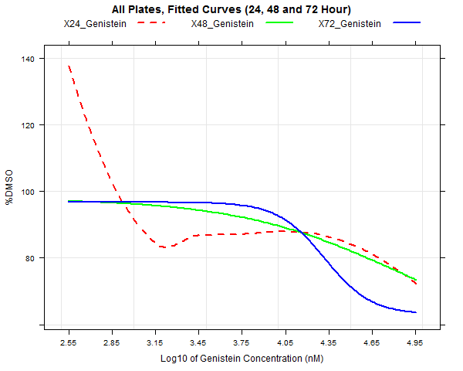
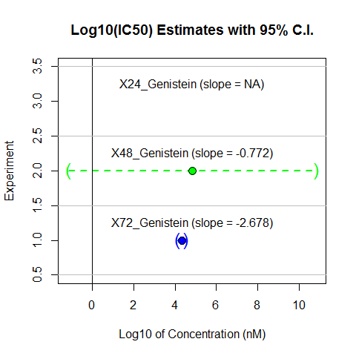
Genistein

Slide 8
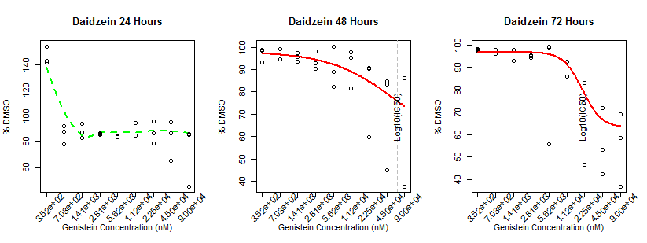
Genistein

Slide 9
Genistein

Slide 10
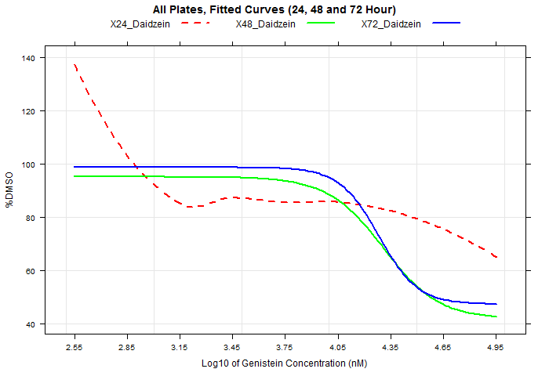
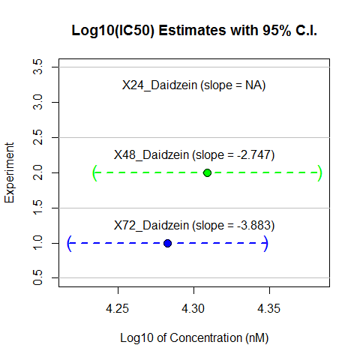
Daidzein

Slide 11
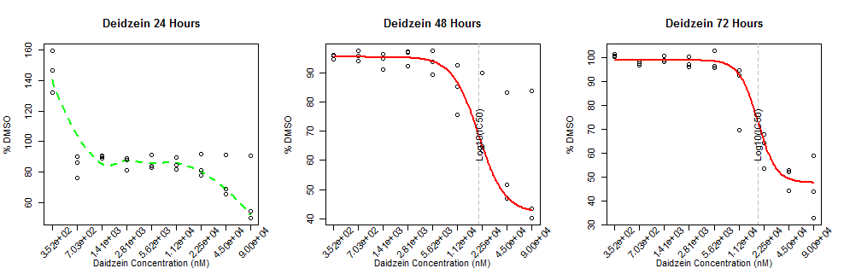
Daidzein

Slide 12
Daidzein

Slide 13
Discussion
No effect at 24 Hours
Higher starting concentration might be needed to observe full curves at 48 hours, although enough data was collected to estimate IC50s at 48 and 72 hours

